Slide 1

Sales Insights Analysis for Atliq Hardware
A Data-Driven Solution Using Power BI

Slide 2
Introduction
Challenges Faced:
Inefficient sales tracking through verbal updates and Excel files.
Lack of clear, actionable insights for decision-making.
Solution Provided:
Developed an interactive Power BI dashboard to provide clear, actionable sales insights.

Slide 3
Project Goals
Streamline sales tracking.
Enable data-driven decision-making.
Reduce costs by 10% and increase sales by 5%.

Slide 4

Key Features of the Dashboard
ETL Process Using Power BI:
Connected to MySQL database and used Power Query for data transformation.
Established a star schema for the data model.
Enhanced Visualizations:
Created interactive visualizations to track revenue and sales trends by region and product.
Profit Margins and Contribution Analysis:
Incorporated measures to identify the most profitable customers and regions.
Added dynamic elements to highlight underperforming zones.

Slide 5
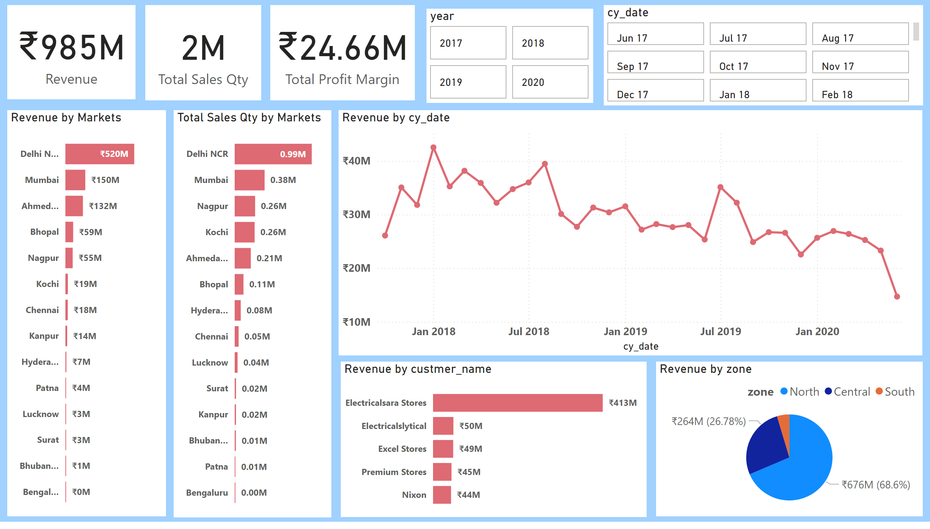

Slide 6
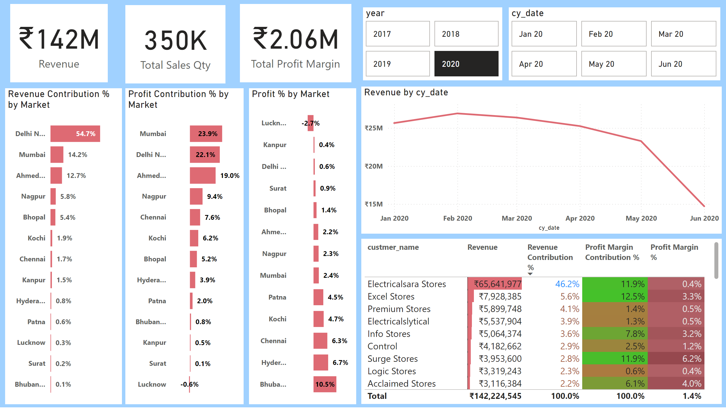

Slide 7
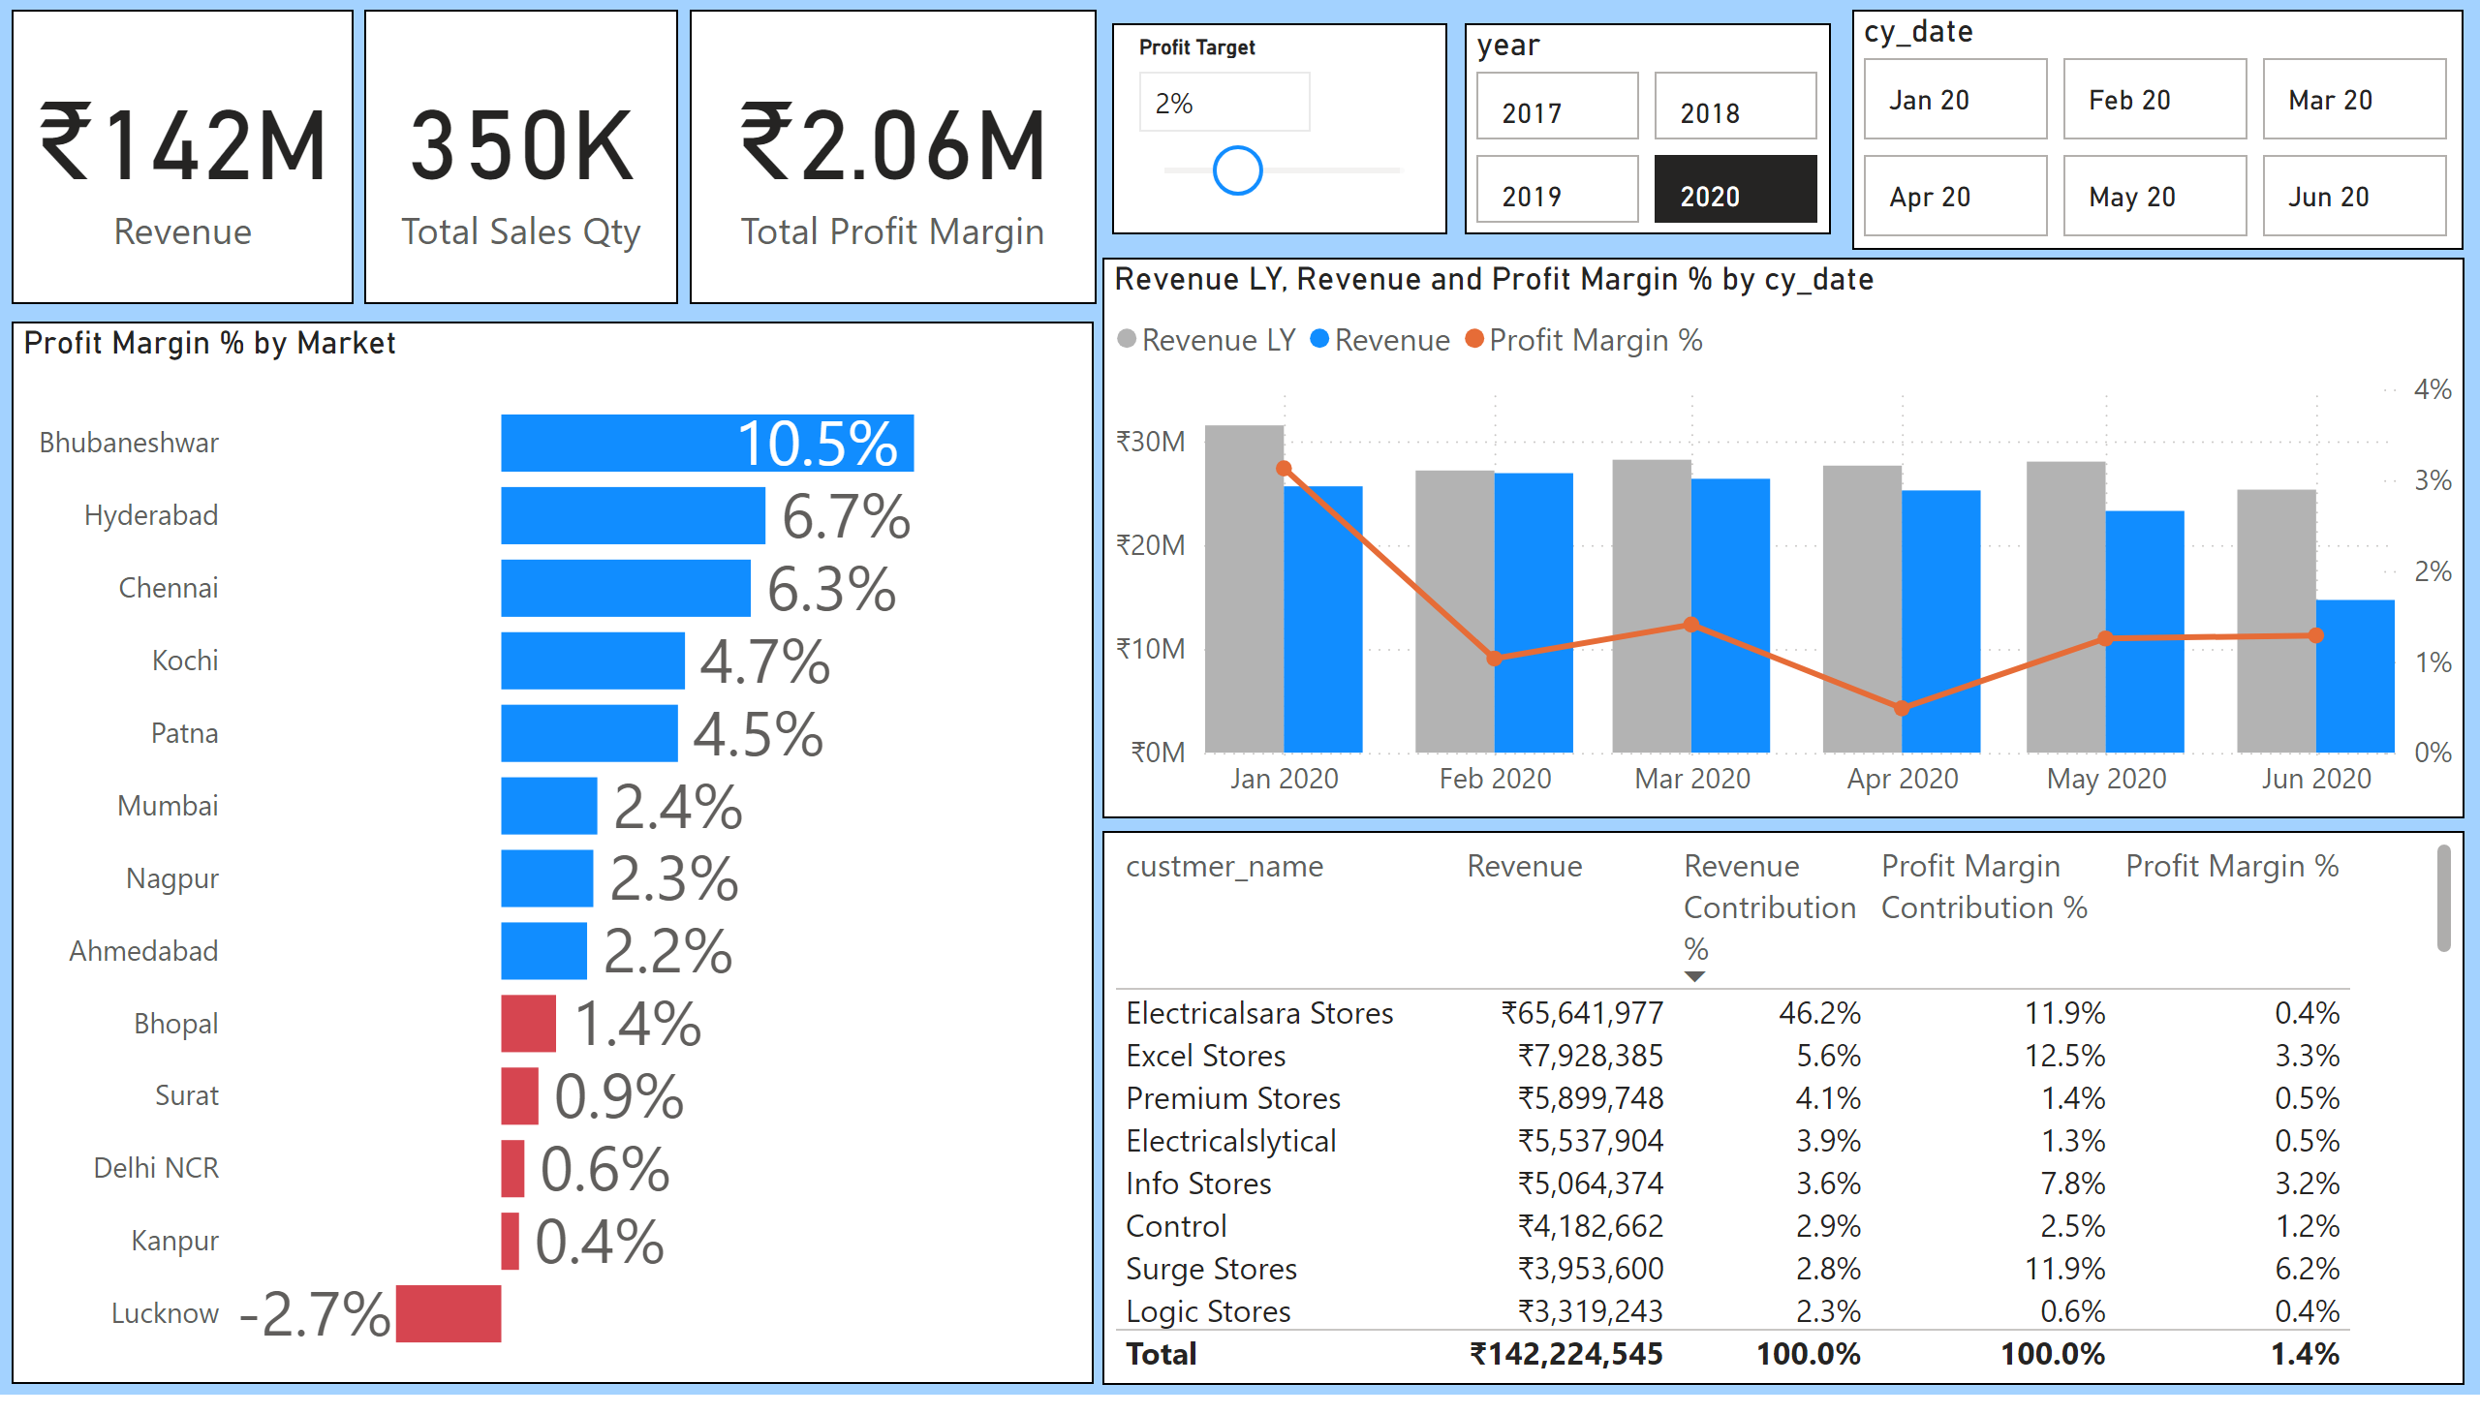

Slide 8

Key Insights of the Dashboard
Key Metrics:
Total Revenue: ₹985M
Total Profit Margin: ₹24.66M
Total Sales Quantity: 2M
Visualizations:
Revenue and Profit Trends.
Market-wise and Product-wise Performance

Slide 9
Insights from Dashboards
Top-Performing Markets:
Delhi NCR contributed ₹520M in revenue.
Mumbai performed well with ₹150M.
Underperforming Markets:
Bengaluru, Bhubaneshwar
Profit Contribution:
Delhi NCR: 22.1%, Mumbai: 23.9%.

Slide 10
Market Insights
Profit % by Market:
Top Markets: Bhubaneswar (10.5%), Hyderabad (6.7%), Chennai (6.3%)
Lower Performance Markets: Lucknow (-2.7%), Kanpur (0.4%), Delhi NCR(0.6%)
Revenue Contribution % by Market:
Highest Contributors: Delhi NCR (54.7%), Mumbai (14.2%), Ahmedabad (12.7%)
Lower Contributors: Lucknow (0.3%), Surat (0.2%), Bhubaneswar (0.1%)
Profit Contribution % by Market:
Top Profit Contributors: Mumbai (23.9%), Delhi NCR (22.1%), Ahmedabad (19.0%)
Lowest Profit Contributors: Lucknow (-0.6%), Surat (0.1%), Kanpur (0.5%)

Slide 11

Recommendations
High-Performing Markets: Boost marketing and loyalty programs in Delhi NCR and Mumbai to maintain leadership.
High Margin Markets: Expand efforts in Hyderabad, Chennai, and Bhubaneswar to capitalize on profitability.
Low-Performing Markets: Improve localized strategies for Lucknow, Surat, Bhubaneswar, Kanpur, and Patna to unlock potential.
Sales Strategies: Plan seasonal promotions, dynamic pricing, and ensure consistent revenue stabilization.
Cost Efficiency Goal: Reduce costs by 10% and increase sales by 5% through optimized strategies.

Slide 12

Conclusion
The sales performance shows a total revenue of ₹985M, with 2M units sold and a total profit margin of ₹24.66M. The key markets contributing positively are Bhubaneswar, Delhi NCR, and Ahmedabad, whereas Lucknow and Surat lag in performance.
Notably, revenue trends have shown a decline from January 2020 to June 2020, suggesting potential challenges or market shifts during this period.
To improve, focus on boosting underperforming markets and understanding the cause of the revenue decline.

